Slide 1
Ant colony optimization with TSP Problem
En Li, Yangxiao Wang, Leonard Li
CSS 534 Parallel Programming in Grid and Cloud
Final Project

Slide 2
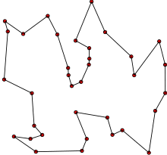
Traditional TSP Problem
Given a set of locations (cities) and the distances between them, find the shortest possible route that each city is visited only once and return to the origin city.

Slide 3
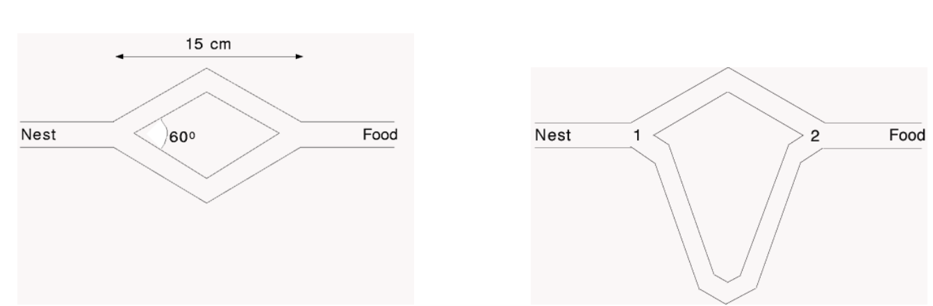
Ant Colony Preview
Double-bridge experiment
If the experiment is repeated a number of times, it is observed that each of the two bridges is used in about 50% of the cases. About 100% the ants select the shorter bridge

Slide 4
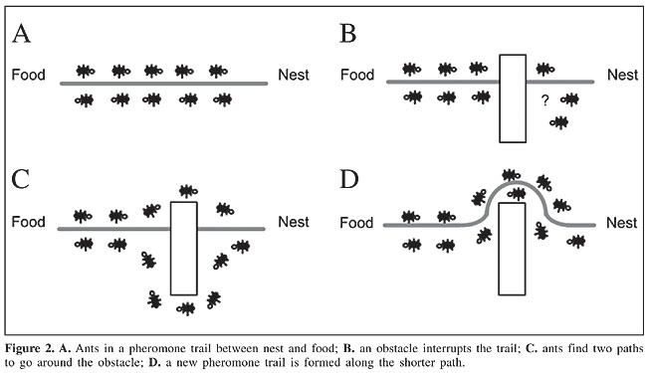
Cont’
source:https://www.funpecrp.com.br/gmr/year2005/vol3-4/wob09_full_text.htm
Notes:
Ants in a pheromone trail between nest and food;
An obstacle interrupts the trail
Ants find two paths to go around the obstacle
A new pheromone trail is formed along the shorter path

Slide 5
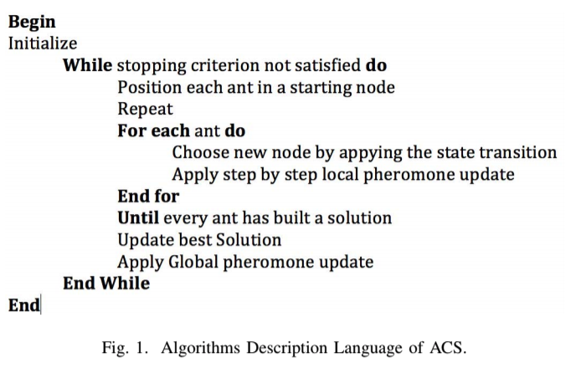
PseudoCode
Source: https://drive.google.com/drive/u/2/folders/0AHM8M__jpRKmUk9PVA

Slide 6
Parallel Strategies
Five possible parallelisation strategies for ACO meta-heuristics
Parallel Independent Ant Colonies （not for master/slave approach）
Parallel Interacting Ant Colonies
Parallel Ants
Parallel Evaluation of Solution Elements
Parallel Combination of Ants and Evaluation of Solution Elements

Slide 7

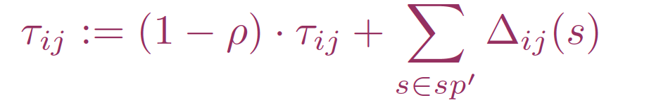
MPI-JAVA
MPI-JAVA environment setup
Parallel simulation (Parallel Interacting Ant Colonies)
Distribute the Ant[] by rank size (Parallel Ants, Geometric Decomposition)
Update global maps using MPI communication like MPI_Gather(), MPI_Scatter() (Synchronization)
The Parameters Tuning (How many ants? The pheromone update rate, The possibility of mischoosing path for ants, Performance cost during sync communication )

Slide 8

MapReduce
Convert source file (vertices with weight and neighbors) to mapper and construct the graph
Initialized ants and update global pheromone array (could be multiple ants inside a single mapper)
Ants choose path based on attractiveness (reciprocal of the distance of the edge)
Return a key-values with the same key (same reducer)
Traversal the key-values and calculate best route
Should be fast because it just iterate through the map based on pheromone level
Store data into a binary file
Repeat from 1 with the new input and modified mapper (chaining MapReduce jobs)
Ants choose path based on pheromone and attractiveness

Slide 9

Spark
Consume graph input file and generate an RDD using input file using parallelize().
Will also need an additional data structure for a map that contains edge as key and and pheromone as value.
While loop: terminates when given number of iterations has been reached.
Within the loop: Map(): For each ant, move 1 step based on a possibility (which will be tuned manually). Obtain RDD of key value pairs where key is distance and value is path, ReduceByKey() to find shortest path. Update global pheromone with shortest path found. Repeat.

Slide 10
MASS
Construct the graph and initialize ants represented by agents
Exchange the update pheromone data and, inside the cyclic simulation
Should easy to implement with Ant Colony optimization since the idea is similar
Not familiar with the api

Slide 11
Question?
Thank You ~

